Slide 1
Quantitative Methods in Genetic and Genomics Single Cell Module
Rob Morey
Adapted from
Alex Chaim, Ph.D.
January 29th, 2019

Slide 2


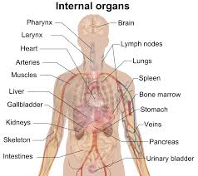

Why single cell transcriptomics?
Microarrays or bulk RNA sequencing mask the true distribution of gene expression levels across cells.
Notes:
How do we know what we are looking for if we don’t know what it looks like?

Slide 3
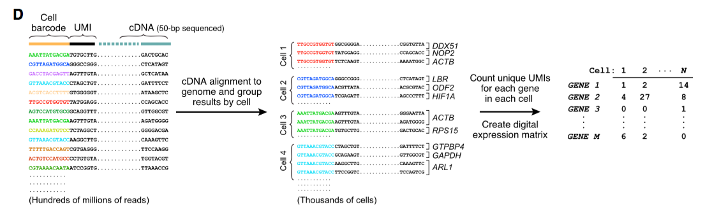
Counts Matrix
How do we get there?

Slide 4
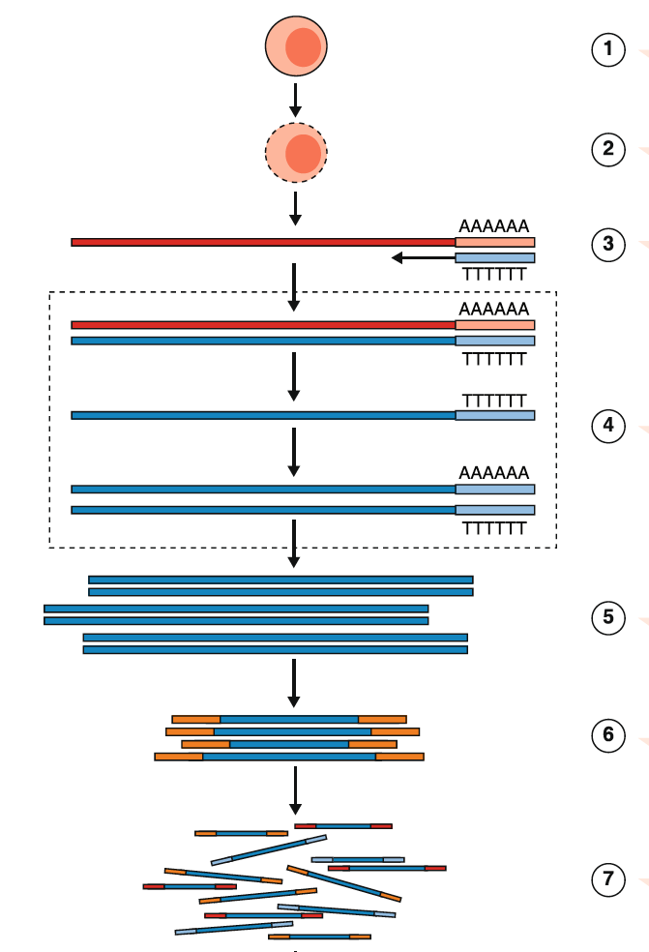
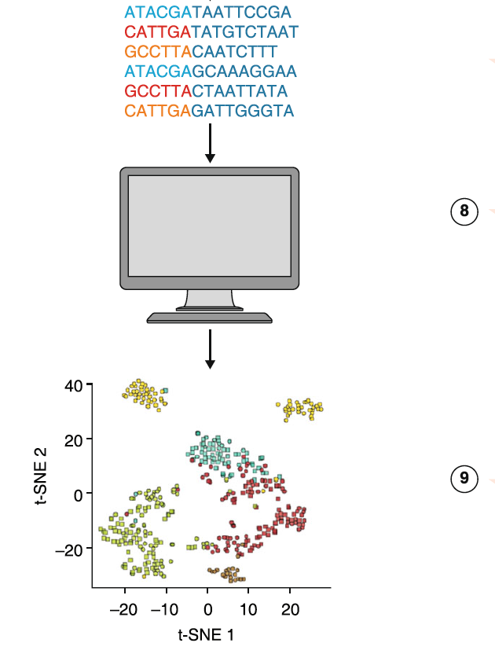
General workflow of a single cell (sc) RNA-Seq experiment
Haque et al., 2017 Genome Medicine

Slide 5
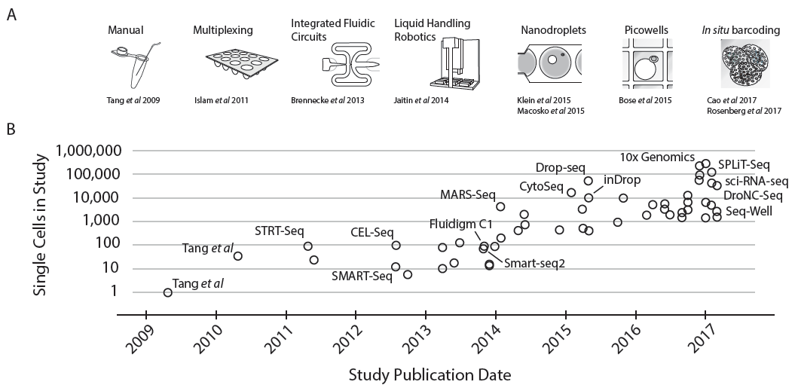
scRNA-Seq has become more popular, high(er) throughput and “more” affordable
Full-length mRNA
Few cells
3’-end mRNA
Many cells
Svensson et al., 2017 arXiv:1704.01379

Slide 6
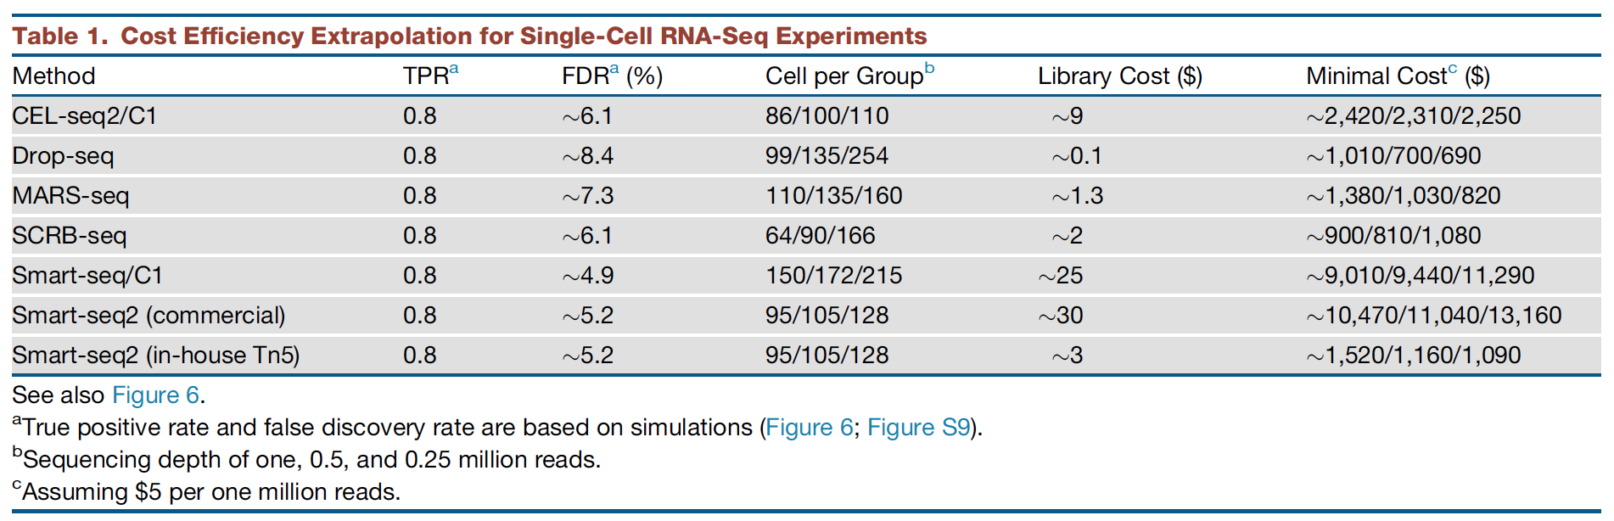
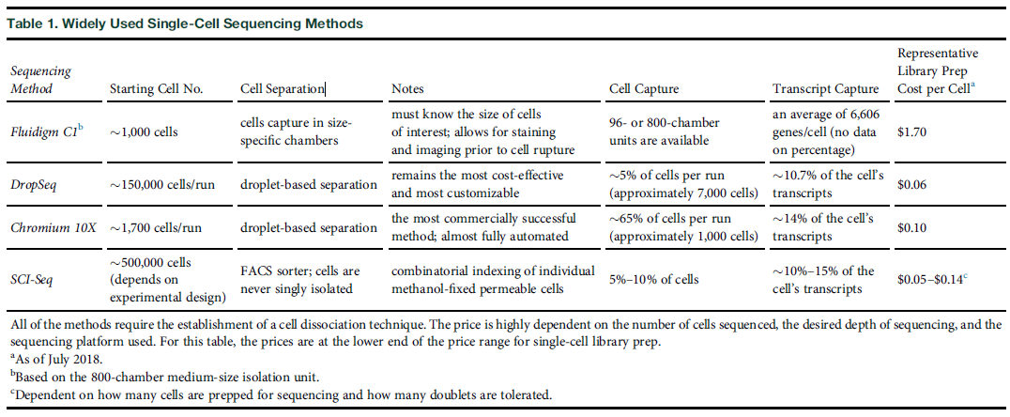
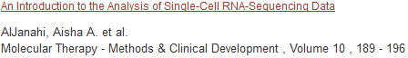
Single cell technologies (3’-end vs full-length)
Ziegenhain et al., 2017 Molecular Cell

Slide 7
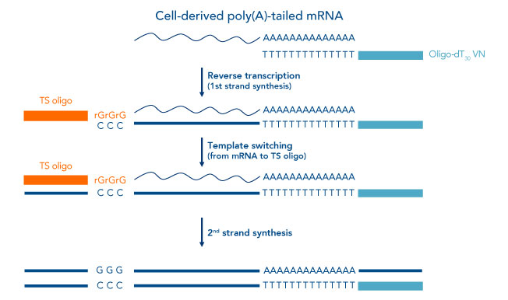
Full length mRNA Reverse Transcription (RT) is enabled by a Template Switching Oligo (TSO)
5’
3’
Notes:
Molon
SMART technology and template switching oligo secure 5' end sequences
Described originally in 2001, a strategy frequently referred to as “SMART” (switching mechanism at the 5' end of the RNA transcript) technology (Takara Bio USA, Inc) has shown promise in generating full-length cDNA libraries, even from single-cell–derived RNA samples [1,3]. This strategy relies on the intrinsic properties of Moloney murine leukemia virus (MMLV) reverse transcriptase and the use of a unique template switching oligonucleotide (TS oligo, or TSO). During first-strand synthesis, upon reaching the 5’ end of the RNA template, the terminal transferase activity of the MMLV reverse transcriptase adds a few additional nucleotides (mostly deoxycytidine) to the 3' end of the newly synthesized cDNA strand. These bases function as a TS oligo-anchoring site. Upon base pairing between the TS oligo and the appended deoxycytidine stretch, the reverse transcriptase “switches” template strands, from cellular RNA to the TS oligo, and continues replication to the 5' end of the TS oligo. By doing so, the resulting cDNA contains the complete 5' end of the transcript, and universal sequences of choice are added to the reverse transcription product. Along with tagging of the cDNA 3' end by oligo dT primers, this approach makes it possible to efficiently amplify the entire full-length transcript pool in a completely sequence-independent manner [4].
TS oligo structure
The simple version of a TS oligo is a DNA oligo sequence that carries 3 riboguanosines (rGrGrG) at its 3' end [1]. The complementarity between these consecutive rG bases and the 3' dC extension of the cDNA molecule empowers the subsequent template switching [5]. A more recent study suggested replacing the 3' most rG with a locked nucleic acid base (LNA), possibly due to the enhanced thermostability of the LNA monomer, which would be advantageous for base pairing [6]. Interestingly, a systematic study was conducted in 2013 to compare the multiple modified TS oligo versions side-by-side, and the data indicated that RNA/DNA hybrids provide a superior level of 5' cap-specific enrichment, even though the DNA/LNA duplexes were expected to be more thermodynamically favored [7].

Slide 8
Unique Molecular Identifiers (UMIs) allow to correct for PCR duplication
5’
3’
UMI
UMI
UMI
UMI’
UMI

Slide 9
Bead Barcodes (BBC) allow to assign multiple transcripts (UMIs) to one cell of origin
5’
3’
UMI
BBC
UMI
BBC
UMI
BBC
UMI’
BBC’
UMI
BBC

Slide 10
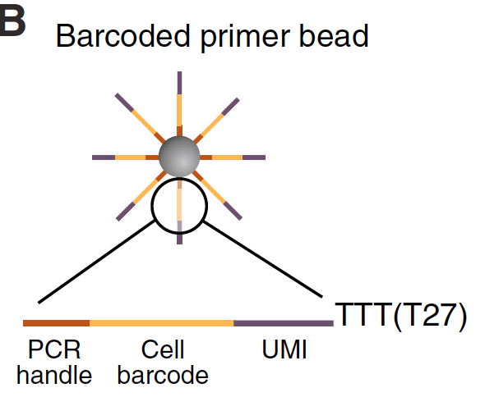
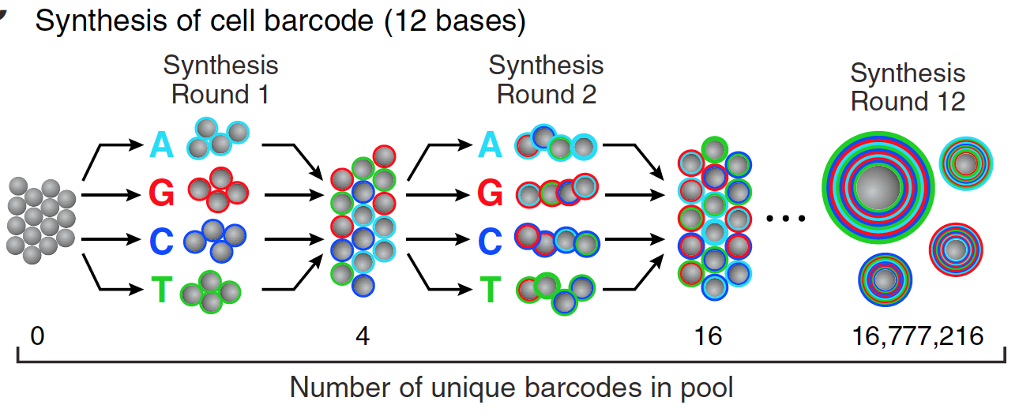
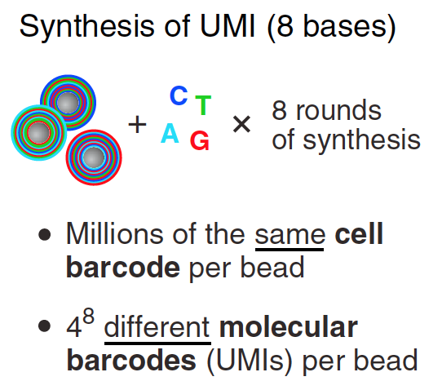
3’-end Capture Beads UMIs and Bead Barcodes
UMI
BBC
PCR
4¹² = 16,777,216 barcodes
4⁸ = 65,536 UMIs
>>10⁶ oligos/bead
Macosko et al., 2015 Cell

Slide 11
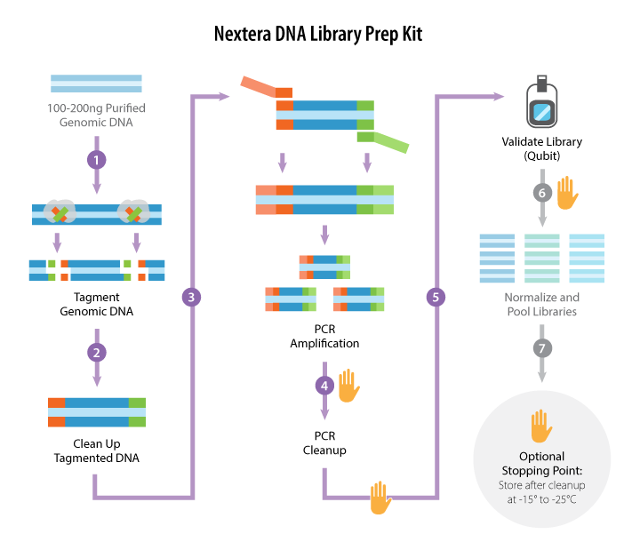
Library Prep Tagmentation
3’-end vs. full-length implications
https://www.abmgood.com/marketing/knowledge_base/next_generation_sequencing_experimental_design.php

Slide 12
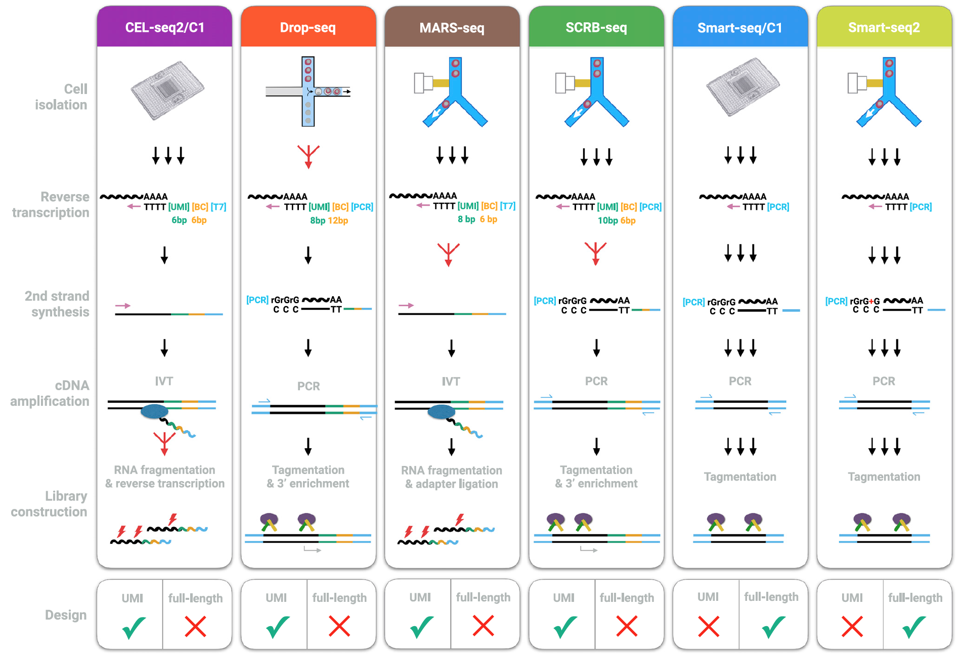
Single cell technologies (3’-end vs full-length)
Ziegenhain et al., 2017 Molecular Cell

Slide 13
Single cell technologies (3’-end vs full-length)
Ziegenhain et al., 2017 Molecular Cell

Slide 14
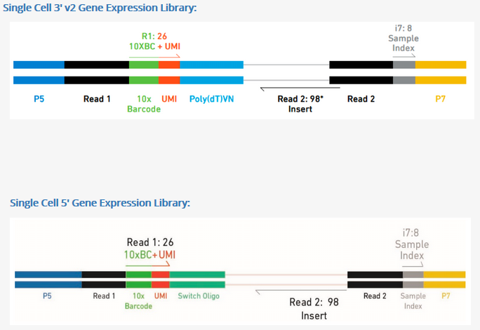
10X now offers 5’-end

Slide 15
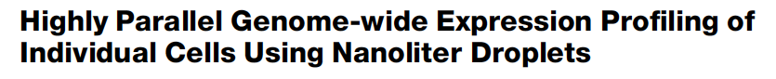
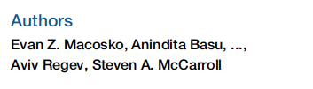
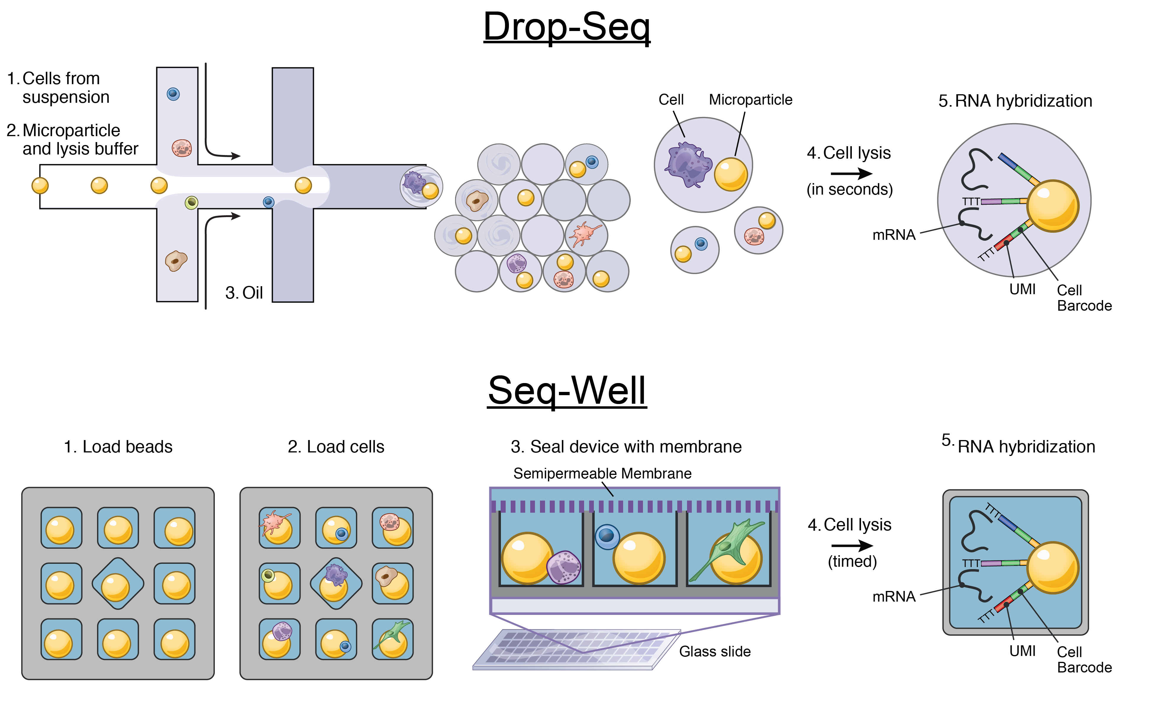
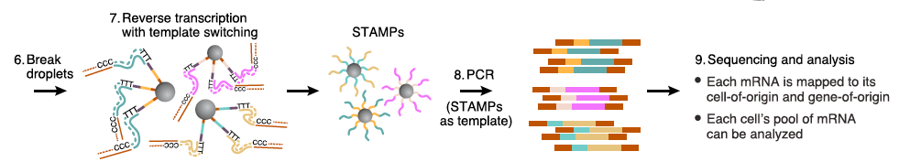
Drop-Seq
Macosko et al., 2015 Cell

Slide 16
Drop-Seq implementation
Capture rate < 10%

Slide 17
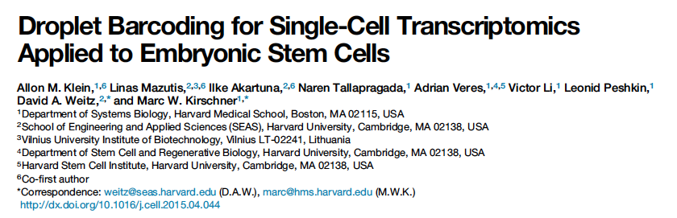

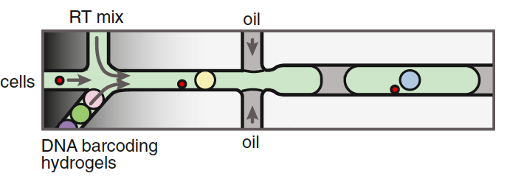
inDrop
Capture rate > 50%
inDrop + DropSeq → 10X

Slide 18
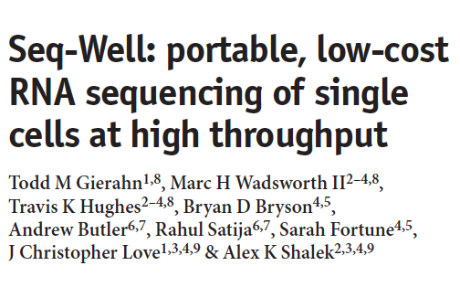

Seq-Well abrogates the need for droplet-based microfluidic devices
Capture rate > 50%

Slide 19
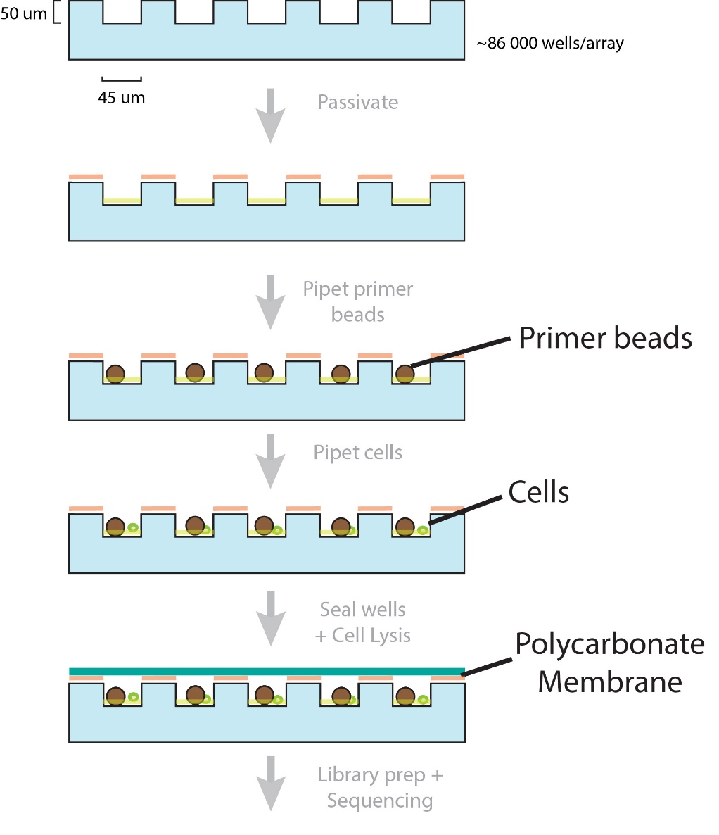
Seq-Well workflow in Images
Pre-wash
100 um
Post-wash + shake
100 um

Slide 20
Seq-Well workflow in Images
Pre-cell loading
100 um
Post-cell loading + shake
Cell
Bead
100 um
Capture rate > 50%

Slide 21
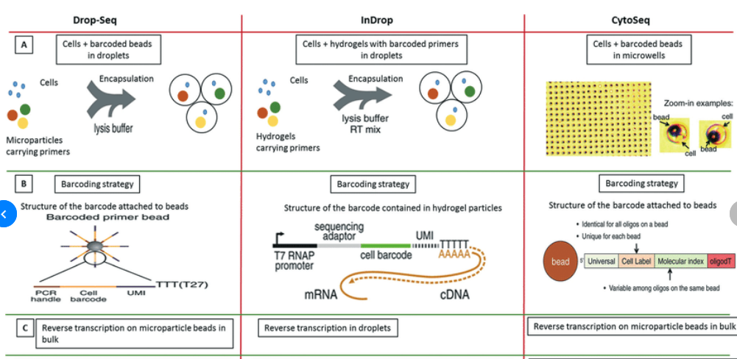
Method Comparison
Shembekar, et al. (2016). Droplet-based microfluidics in drug discovery, transcriptomics and high-throughput molecular genetics. Lab Chip. 16. 10.1039/C6LC00249H.
Notes:
The Drop-seq method involves co-encapsulation of cells along with beads coated with primers into droplets. The inDrop method involves co-encapsulation of cells along with a reverse transcription (RT) mix and hydrogel particles carrying primers that can be released upon UV excitation. The Cyto-seq method involves the seeding of single cells and beads in microwells with picoliter volumes. (B) The barcoding strategy is fairly similar amongst all the methods, with initial universal sequence for PCR/sequencing, followed by a cell barcode, then a unique molecular identifier (UMI) sequence and a poly-dT sequence to capture mRNAs. (C) There are few differences in RT reaction of the captured mRNAs. In Drop-seq method, the RT reaction is carried out on the captured mRNAs on the beads after breaking the droplets. In InDrop method, the RT reaction is carried out inside the droplets. In Cyto-seq, the RT reaction is carried out in bulk after pooling all the beads and thereby the captured mRNAs with them.

Slide 22


Doublet rate: Barnyard Experiment

Slide 23
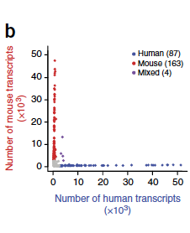
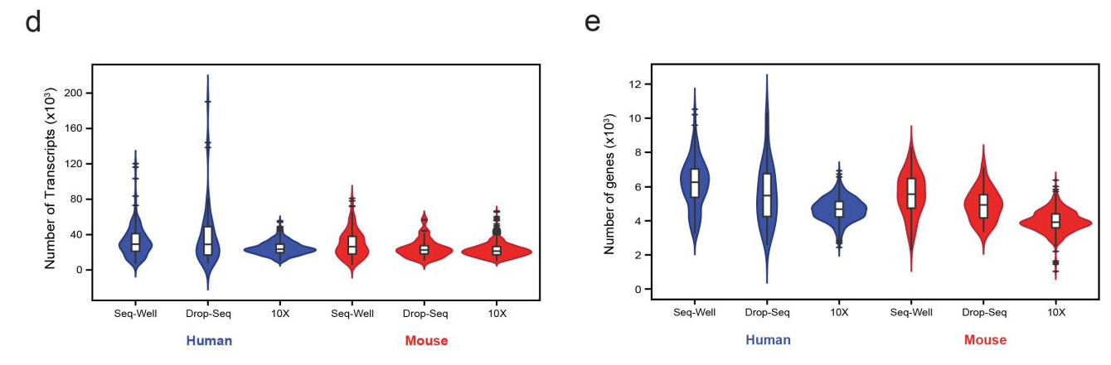
Doublet rate: Inter-platform comparison

Slide 24
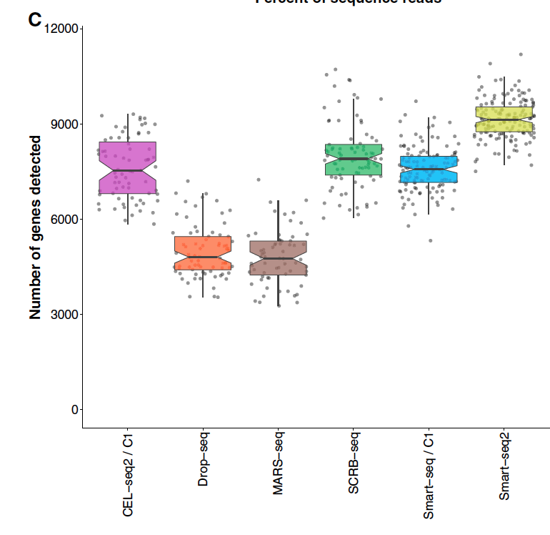
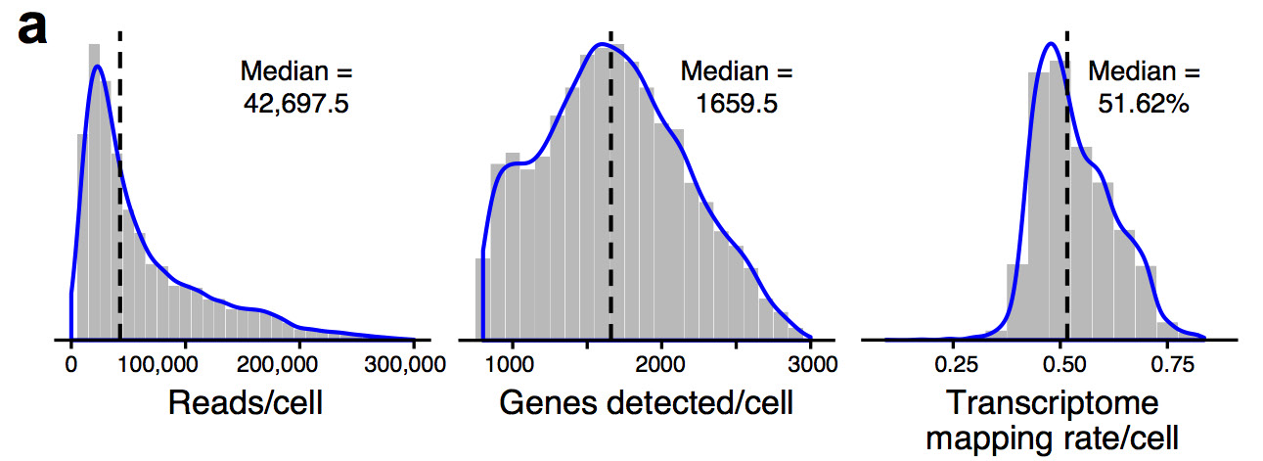
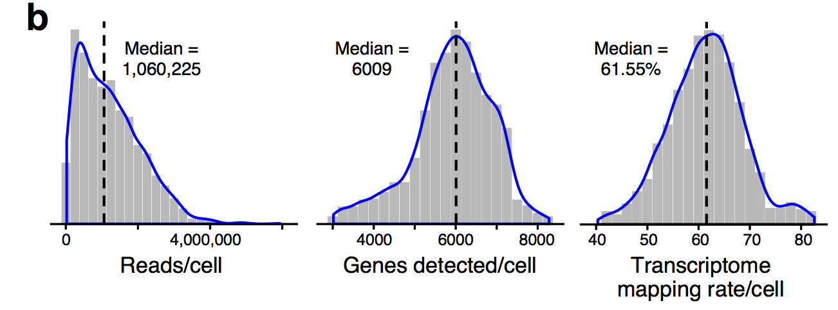
3’-end vs full-length Inter-platform comparison
10X
Smart-Seq2
Ziegenhain et al., 2017 Molecular Cell
Haber et al., 2017 Nature

Slide 25
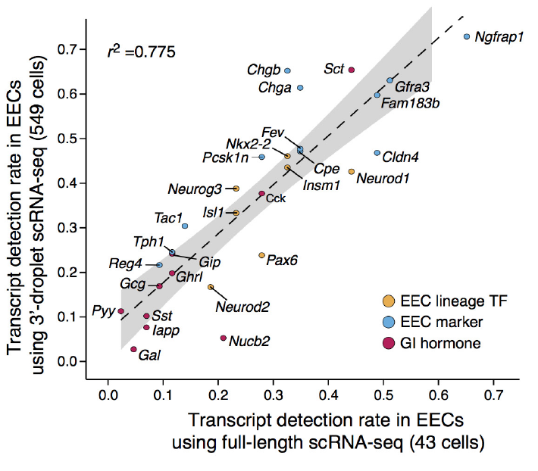
3’-end vs full-length Inter-platform comparison
Haber et al., 2017 Nature

Slide 26
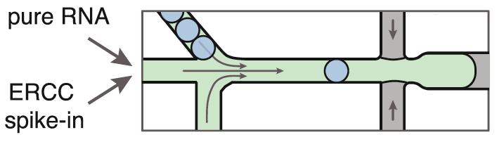
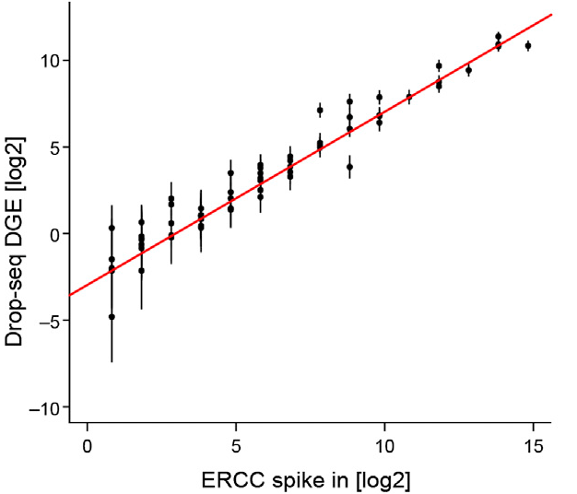
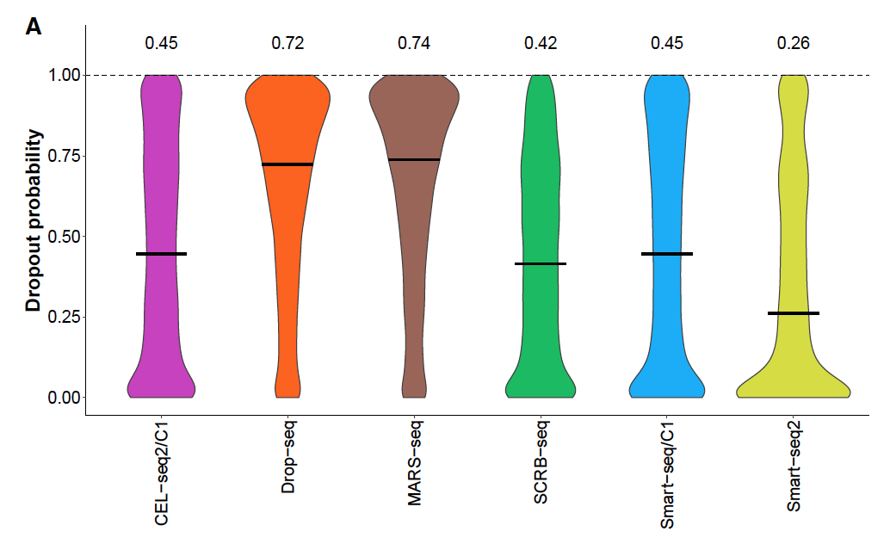
Dropout rates ERCC spike-ins
ERCC
External RNA Controls Consortium
Inter-platform comparison
Dropout rate
Klein et al., 2015 Cell
Ziegenhain et al., 2017 Molecular Cell
Macosko et al., 2015 Cell

Slide 27
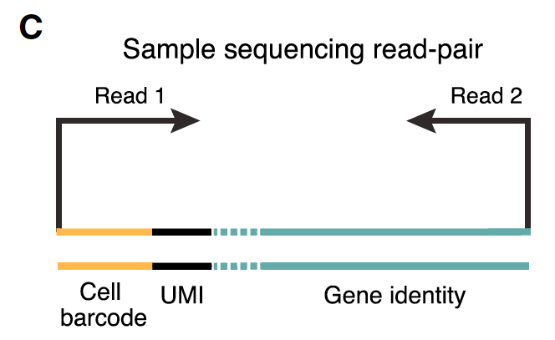
3’-end based technologies Post-sequencing

Slide 28
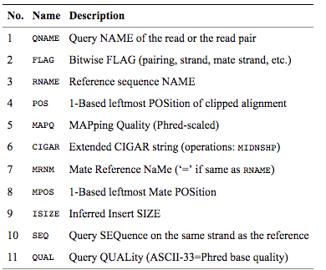
SAM/BAM File
BAM files are binary, you must use samtools to view them
Bioinformatics. 2009 Aug 15;25(16):2078-9. Epub 2009 Jun 8. The Sequence Alignment/Map format and SAMtools.

Slide 29
Analysis pipeline (dropseqtools)
Goal = read1+read2 -> Counts Matrix
Fastqs
Unmapped queryname BAM
Tag cell barcodes
Tag molecular barcodes
Trim 5’ primer sequence
Trim 3’ polyA sequence
STAR alignment
Sort STAR alignment in queryname order
Merge STAR alignment tagged SAM to recover cell/molecular barcodes
Add gene/exon and other annotation tags

Slide 30
From beads … through mRNA capture ... sequencing ... to counts matrix
Split and Pool x 12 = Bead Barcode
…PCRHANDLEJJJJJJJJJJJJJJJJ
Equimolar Mix of four bases x 8 = UMI
…PCRHANDLEJJJJJJJJJJJJJJJJNNNNNNNN
T x 30 = polyT
…PCRHANDLEJJJJJJJJJJJJJJJJNNNNNNNNTTTT...TTTTT
mRNA hybridization + RT + …
…PCRHANDLEJJJJJJJJJJJJJJJJNNNNNNNNTTTT...TTTTT...mRNAmRNAmRNAmRNAmRNA
Notes:
Methacrylic polymer

Slide 31
Analysis pipeline (dropseqtools)
Goal = read1+read2 -> Counts Matrix
Fastqs
Unmapped queryname BAM
Tag cell barcodes
Tag molecular barcodes
Trim 5’ primer sequence
Trim 3’ polyA sequence
STAR alignment
Sort STAR alignment in queryname order
Merge STAR alignment tagged SAM to recover cell/molecular barcodes
Add gene/exon and other annotation tags
Read1
...JJJJJJJJJJJJJJJJNNNNNNNNTTTTTTT
Read 2
...mRNAmRNAmRNAmRNAmRNA

Slide 32
3’-end based technologies Post-sequencing

Slide 33
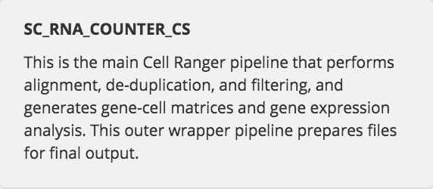
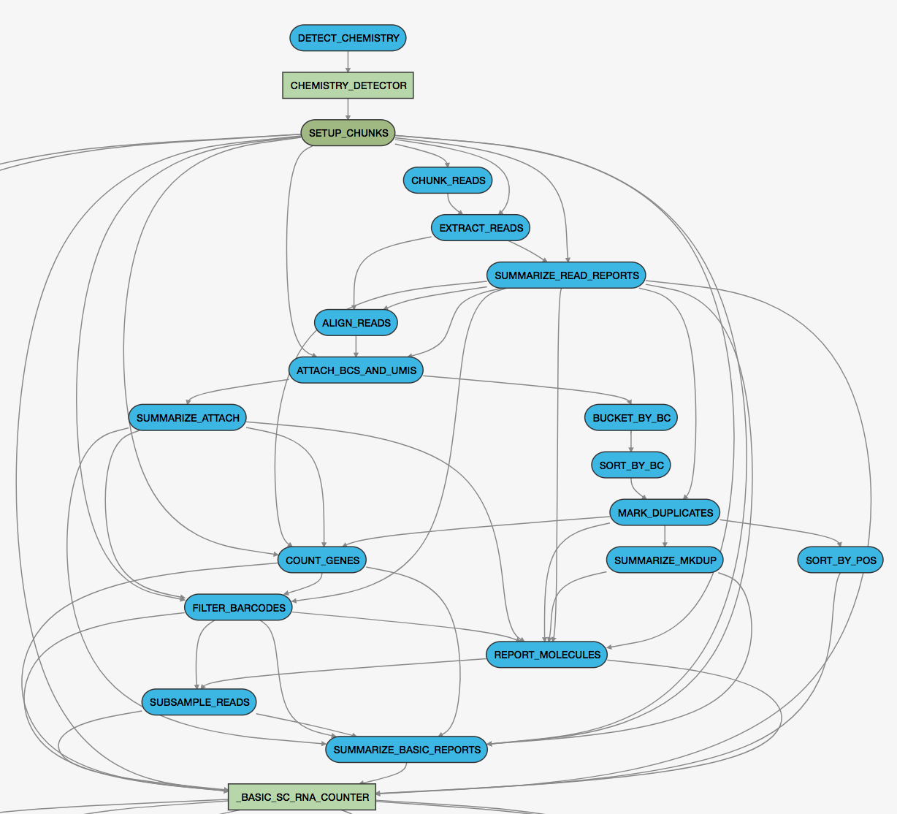
10X - cell ranger pipeline

Slide 35
Template switching PCR is an alternative strategy that ensures the full transcription of the RNA. This method is based on the intrinsic ability of the transcriptases of the Moloney murine leukaemia virus (MMLV) to add a small number of nucleotides (mostly cytosines) when the RT reaches the end of the mRNA (Zhu et al., 2001).

Slide 36
Library prep for sequencing
5’
Barcoded bead + mRNA
3’
TTT
mRNA capture in microwells
5’ cap
3’
bulk
TTT
CCC
RT
TTT
PCR-amplify template
Transposome, adaptor oligos
Tagment library,
amplify
TTT
~350 – 850 bp
20 bp 5’ read (barcode, UMI), 50 bp 5’ read (mRNA sequence tag)
modified from Macosko, et al. Cell 161:1202

